Slide 1

Management and Organizational Behavior Dynamics
Er. Jaskiran Kaur
Assistant Professor

Slide 2
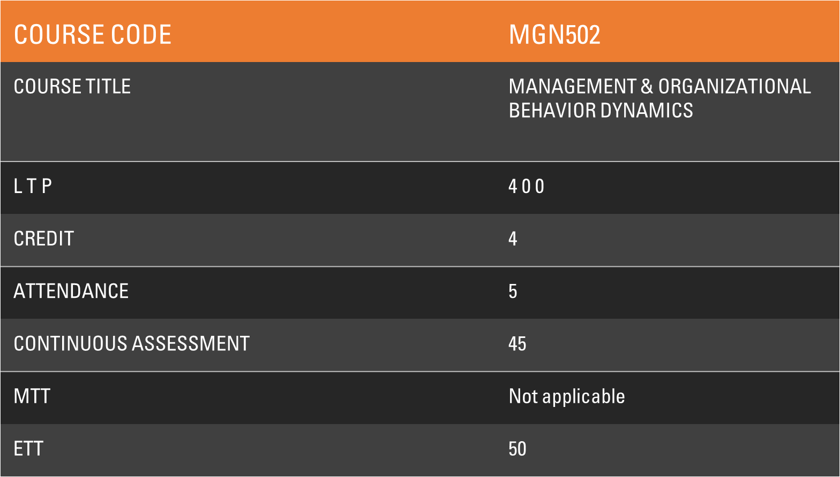

Slide 3
EXAMINATION CATEGORY | X3
CA CATEGORY | A0203
COURSE ORIENTATION | Knowledge Enhancement, Placement Examination, Competitive Examination(Higher Education)

Slide 4
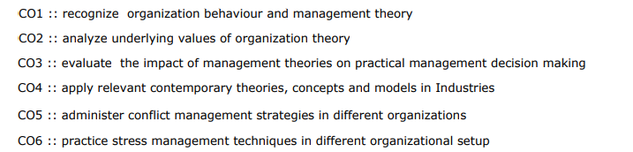
COURSE OUTCOMES

Slide 5
PROGRAMME OUTCOMES
PO1 : Decision Making: : Developing responsiveness to contextual social issues and exploring solutions in the light of social and business ethics.
PO2 : Problem Solving : Apply research tools for analytical decision making and problem solving using cross functional information.
PO3 : Global Outlook : Demonstrate a global outlook with the ability to identify aspects of the global business and Cross-Cultural Understanding
PO4 : Domain Knowledge : Leveraging domain knowledge for organizing information, analysis and exploring business opportunities
PO5 : Communication : Exercise effective written and oral communication skills in business and social interactions.
PO6 : Leadership : Demonstrate proactive leadership and building effective teams to handle challenging assignments.
PO7 : Entrepreneurship : Evaluate and execute ideas for entrepreneurship while taking calculated risks.

Slide 6
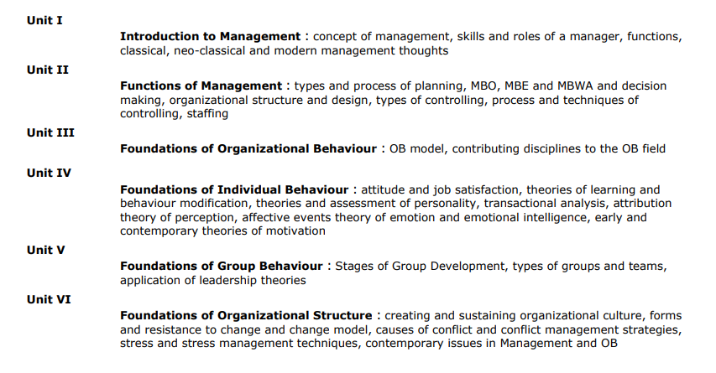
COURSE CONTENT

Slide 7
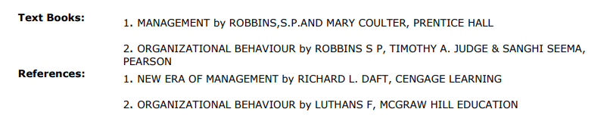
TEXTBOOKS & REFERENCE BOOKS

Slide 8

Practical Application

Slide 9




Slide 10
Pedagogy
Class Discussions
Activity Sessions
News Discussions
Simulations
Video Sessions
Case Study
Presentations

Slide 11

Expectations from Students
Be on time to class.
Respond as and when asked to do so.
Download syllabus & Instruction Plan from UMS.
Read ‘The Economic Times’ ,‘Business Standard’ or ‘ The Hindu’ daily.
Observe and analyze the ethical concerns of different companies.
Participate in discussions & debates in class.
Asks questions in case of doubt.
Attempt all the academic tasks with intention to learn.
Contribute to healthy academic environment in class.
ENJOY THE COURSE

Slide 12

Working Together
1.What do you think makes some managers better than others?
2.Do certain characteristics distinguish good managers?

